Slide 1
Design Patterns
Presented by: Prof. Cyrus Rj W. Robles

Slide 2
Outline
Introduction
Types of Design Patterns
Model-View-Controller Architecture

Slide 3
Design Patterns
Design patterns are very popular among software developers. A design pattern is a well-described solution to a common software problem.
Used by experienced software developers. Design patterns are solutions to general problems that software developers faced during software development.
They are proven and tested solutions built upon the knowledge and experience of seasoned software developers.

Slide 4
Benefits of using Design Patterns
Design patterns are already defined and provide an industry-standard approach to solving a recurring problem, so it saves time if we sensibly use the design pattern.
Using design patterns promotes reusability that leads to more robust and highly maintainable code.
It makes our code easy to understand and debug. It leads to faster development and new members of the team understand it easily.

Slide 5
Outline
Introduction
Types of Design Patterns
Model-View-Controller Architecture

Slide 6
Types of Design Patterns
Creational Design Pattern
Deals with the creation of an object.
Structural Design Pattern
Deals with the class structure such as Inheritance and Composition.
Behavioral Design Pattern
Provides solution for the better interaction between objects, how to provide lose coupling, and flexibility to extend easily in future.

Slide 7
Types of Design Patterns
Creational | Structural | Behavioral
Singleton | Adapter | Chain of Responsibility
Factory | Composite | Command
Abstract Factory | Proxy | Interpreter
Builder | Flyweight | Iterator
Prototype | Facade | Mediator
 | Bridge | Memento
 | Decorator | Visitor

Slide 8
Outline
Introduction
Types of Design Patterns
Model-View-Controller Architecture

Slide 9
Model-View-Controller
The Model-View-Controller (MVC) is a well-known design pattern in the web development field.
It is way to organize our code.
It specifies that a program or application shall consist of data model, presentation information and control information.
The MVC pattern needs all these components to be separated as different objects.

Slide 10
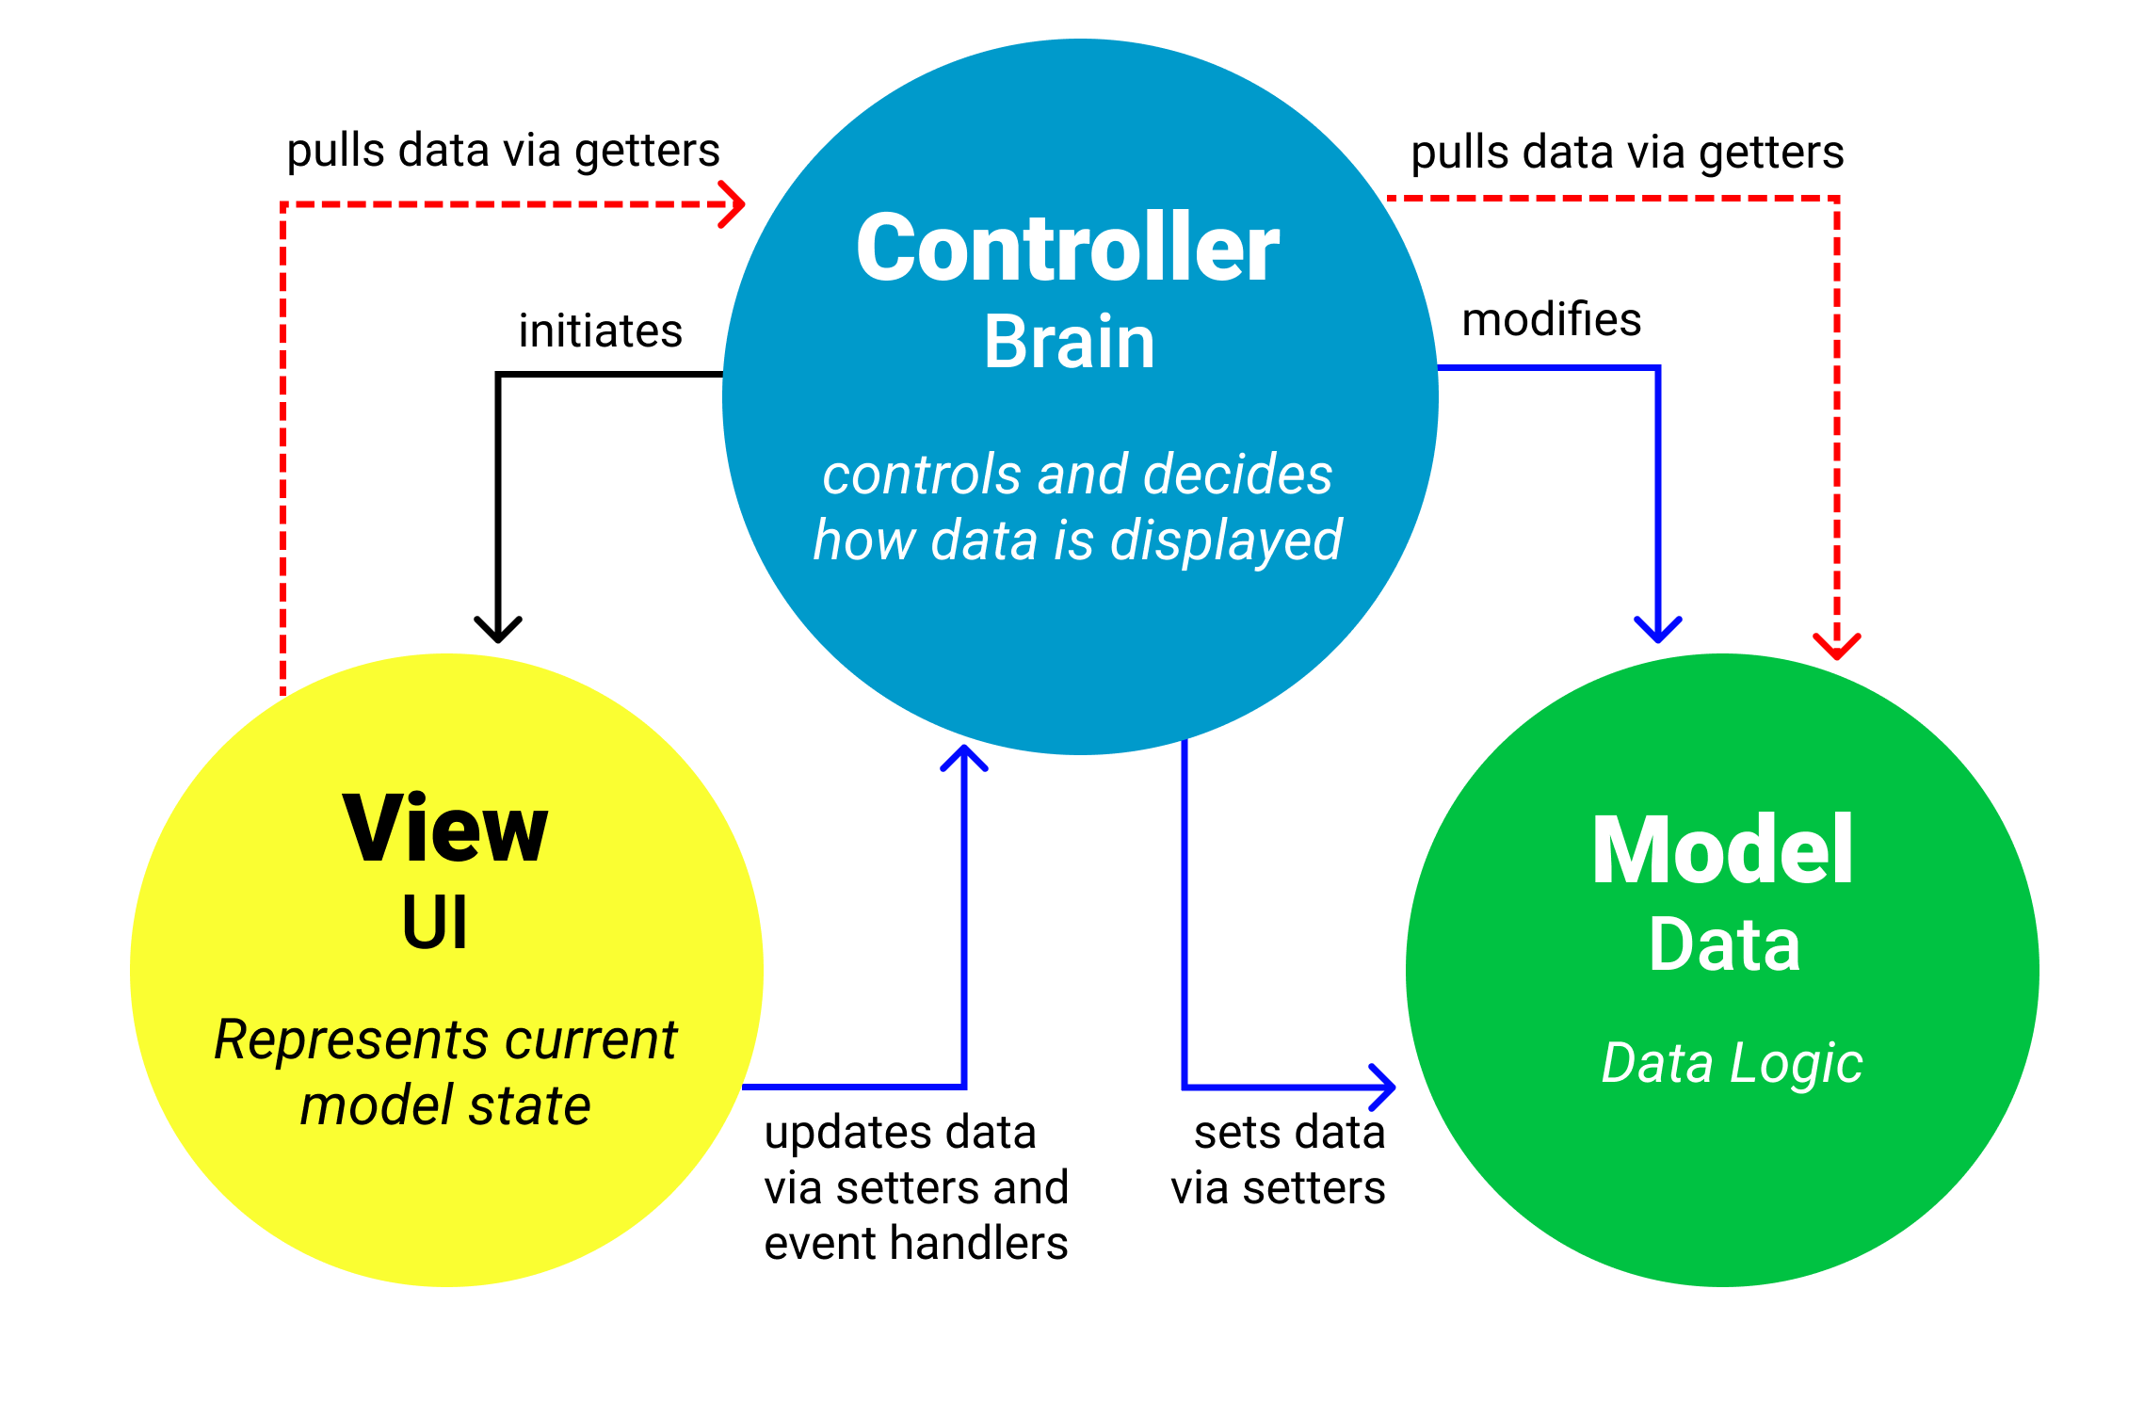
MVC Architecture Pattern

Slide 11
Model Layer
It represents the business layer of application.
The model represents the data and the rules that govern access to and updates of this data.
In the context of Java Swing, Swing's models are divided into two categories: GUI-state models and application data models. GUI state models are interfaces that define a GUI control's visual status, such as whether a button is pressed or armed, similar to ButtonModel. An application-data model is an interface that represents measurable data that the UI displays to the user, such as the value of a cell in a table like TableModel.

Slide 12
View Layer
It represents the presentation layer of application.
It is used to visualize the data that the model contains.
The view renders the contents of a model. It specifies exactly how the model data should be presented.
In the context of Java Swing, The view is a UI component that displays data to the user. Thus, it oversees all UI-related; such as layout and drawing. (e.g. Jtable)

Slide 13
Controller Layer
It works on both the model and view.
It is used to manage the flow of application.
It translates the user's interactions with the view into actions that the model will perform.
In a stand-alone GUI client, user interactions could be button clicks or menu selections.
In the context of Java Swing, A controller contains application code that is performed in response to a user interaction (mouse motion, mouse click, key press, etc.). Controllers may require input in order to function and provide output. They read information from models and update them as a result of the execution. In Swing, a controller is often implemented via an ActionListener or Action.

Slide 14
Thank youuu!!

